Slide 1
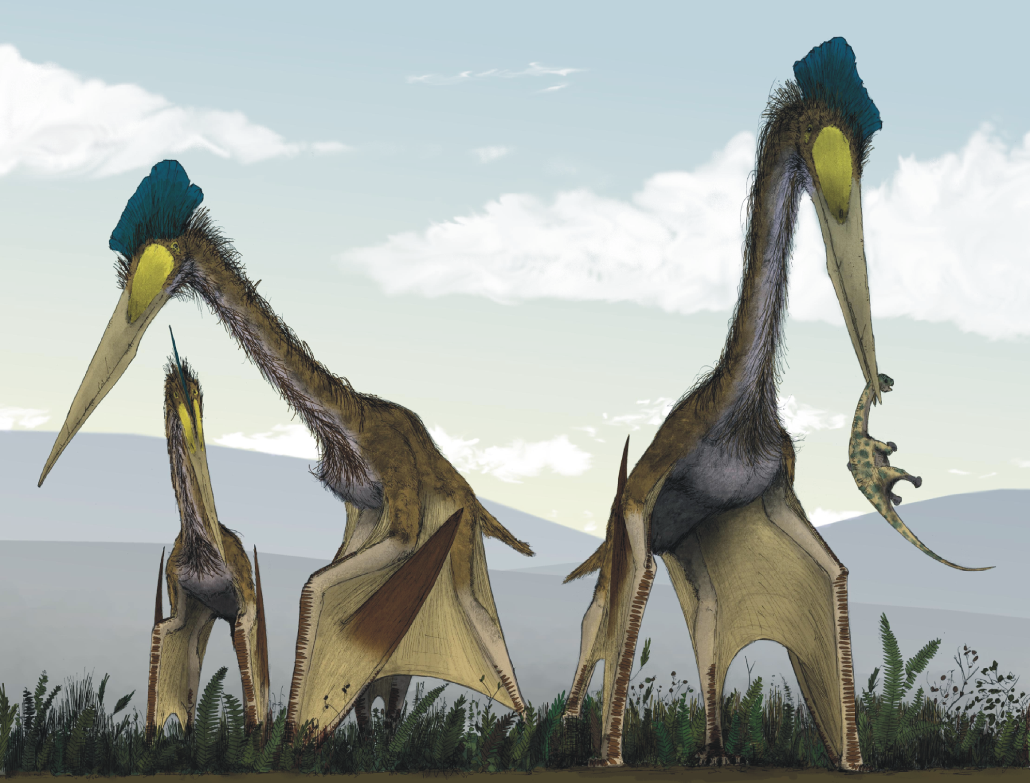
XFLR5 Methods and Their Application in “Constraints on the Wing Morphology of Pterosaurs”
By: Colin Parker

Slide 2
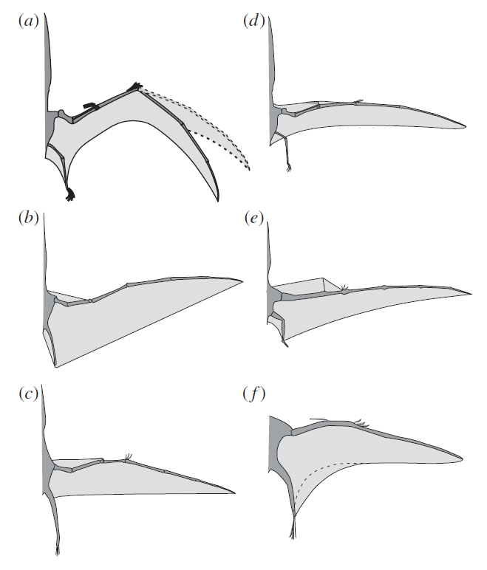
Constraints on the wing morphology of pterosaurs
Wing shape is a mystery
Few soft tissue fossils
No studies looking at the aerodynamic components
Want to combine biomechanical and aerodynamic constraints to predict shape
Notes:
Motivation for study is to recreate wing formation
Fossil records only show hard tissue
Combine biological constraints with aerodynamic
Shown are some
Straite
Swept forward/back

Slide 3
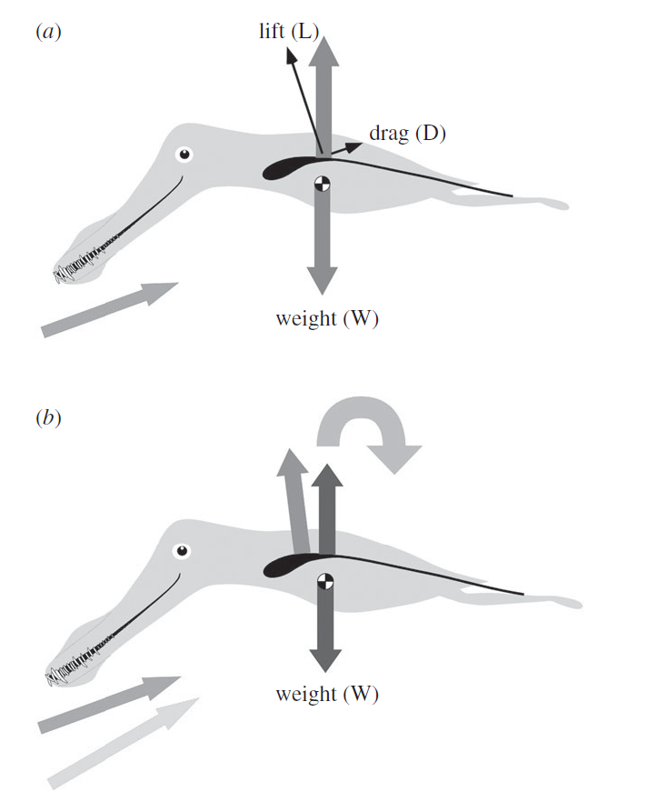
Longitudinal Stability Analysis
Notes:
On aspect is longitudinal stability
Increase lift when ahead of center of mass pitch up
Pitch up increase lift more thus unstable
This paper tried to match Ac

Slide 4
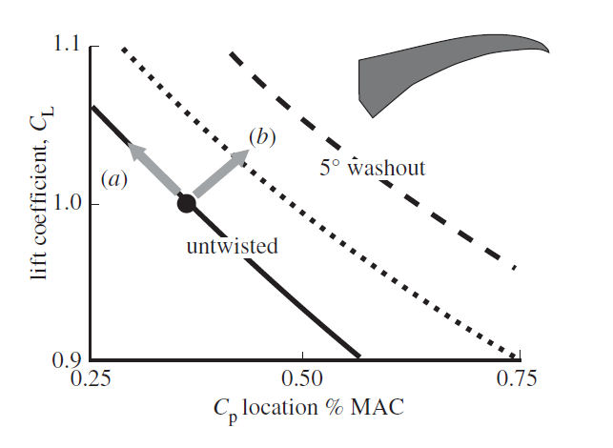
Aeroelastic Effects

Slide 5
Effects of Washout
Notes:
Aeroelastic effects
Plot lift coeffient with center of pressure location
%mac is typicllay taken as the distance from the leading edge of the MAC normalized by the MAC
Don’t have his MAC or MAC position
Applied lift behind the structural nuetral axis causes washout twist forward
t

Slide 6
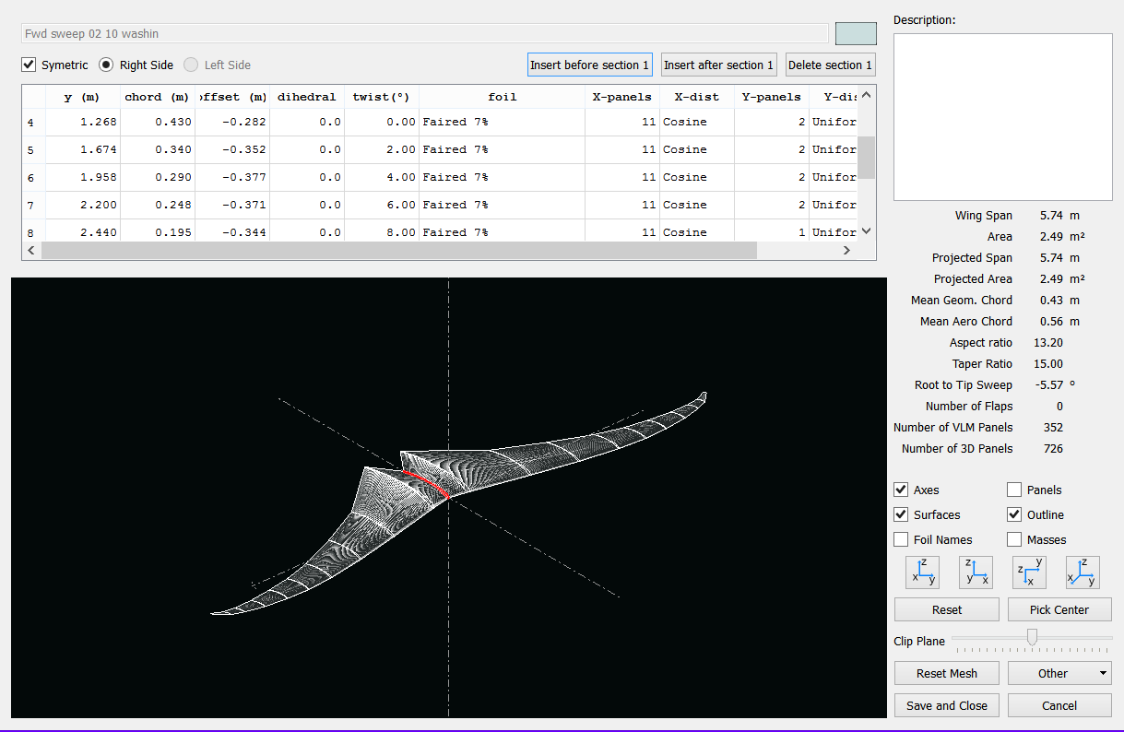
XFLR5
Notes:
Wing geometries in XFLR5, show position chord offest dihedral and twist
Varied the twist distribution from 10 to -10(washout)
Cant see arrow on x but it points back

Slide 7
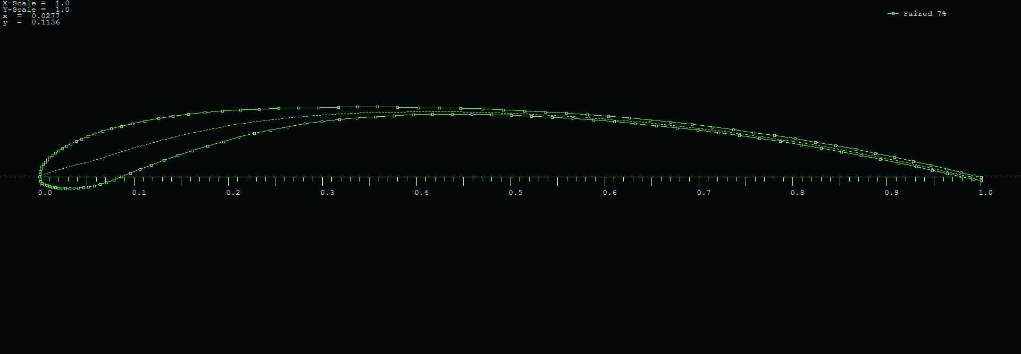
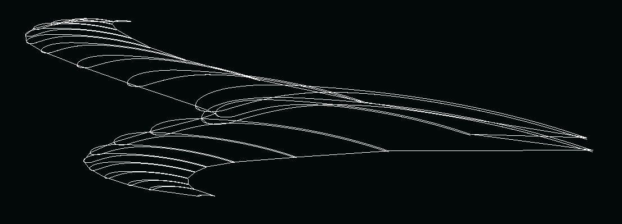
Airfoil Shape

Slide 8
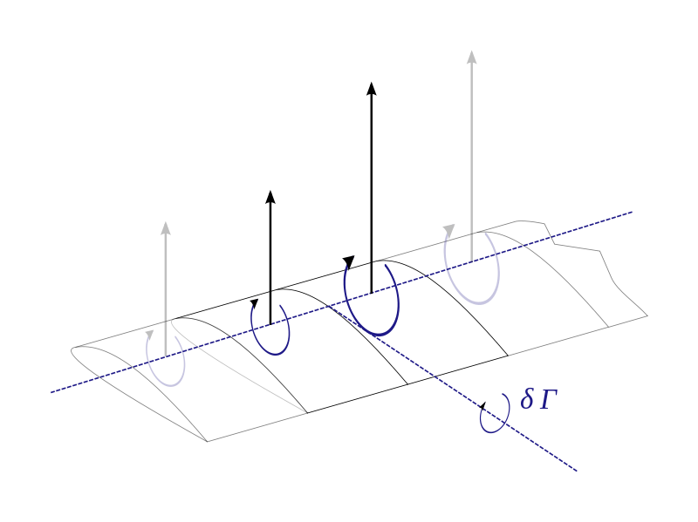
LLT Lifting Line Theory
Kutta_Joukowski
Helmholtz Theorem
The strength of a vortex filament is constant along its length
A vortex filament cannot end in a fluid: must extend to infinity or form a closed path
Biot-Savart
Effective angle of attack
Repeat
Notes:
Uses Xfoil data of CL vs AoA
Lifting line
Kutta relates lift to circulation
Biot-Savart relates circulation to downwash
Helmholtz shape horseshoe vortex

Slide 9
LLT
Limitations
Does not account for sweep
Does not account for dihedral
Inviscid
Must have high Aspect Ratio
Notes:
For this application not the best method
Does not account for sweep
High AR does not

Slide 10
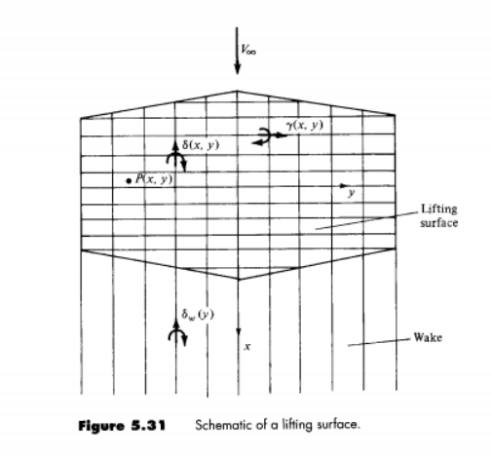
Lifting Surface Theory
Series of lifting lines
Circulation varies in both
Span wise lifting line
Chord wise vortices
Chord wise vortices extend into wake.
Biot-Savart
Flow tangency condition
Notes:
Theory behind the vortex lattice method
Series of lifting line where circulation varies
Chordwise trailing vorticies vary in circulation as well
Apply biot savart
Apply flow tangency

Slide 11
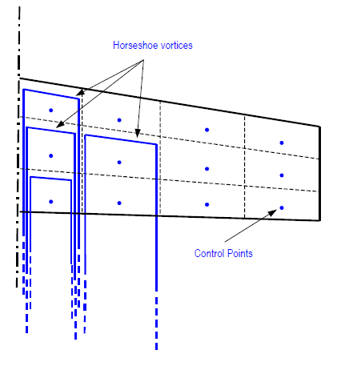
VLM Vortex Lattice Method
Assign circulation at control points
Biot-Savart Law
Flow tangency
Notes:
Numerical approach
Easier to impleiment then solving
Apply circulation at control points

Slide 12
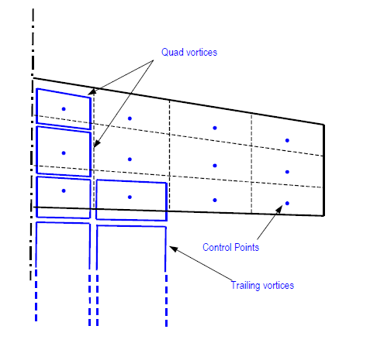
VLM2
Uses quad or ring vortices on surface
Uses horseshoe vortices on trailing edge to model wake

Slide 13
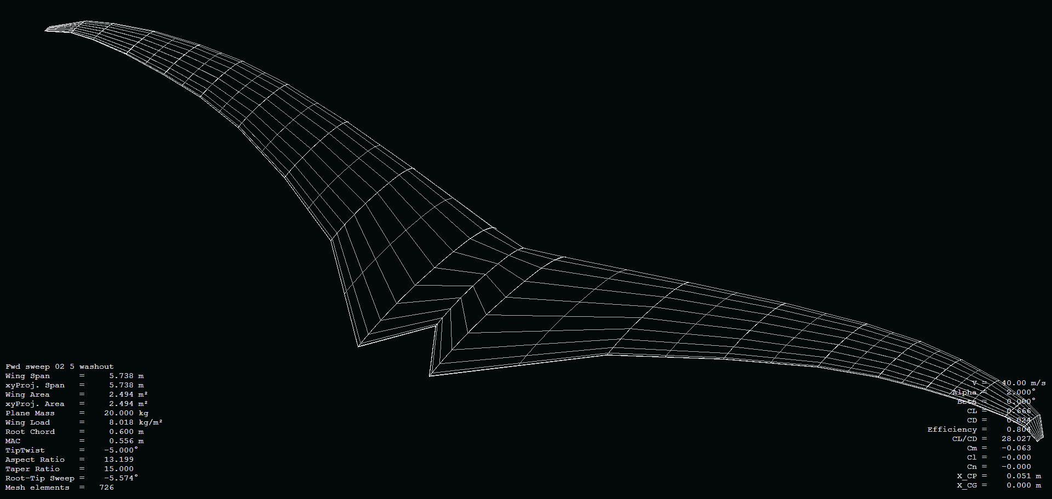
3D Panel Method
Sources and Doublets distributed evenly across each panel
Potential calculated at control points
Boundary layer analysis
Recalculation of potential at control points
Full field calculated with potential field

Slide 14
3D Panel Method
Advantages
Boundary Conditions
Takes into account wing thickness
Maps Cp over top and bottom
Von Nuemann
Tangential flow condition
Dirichlet
Potential inside body = Freestreem potential

Slide 15
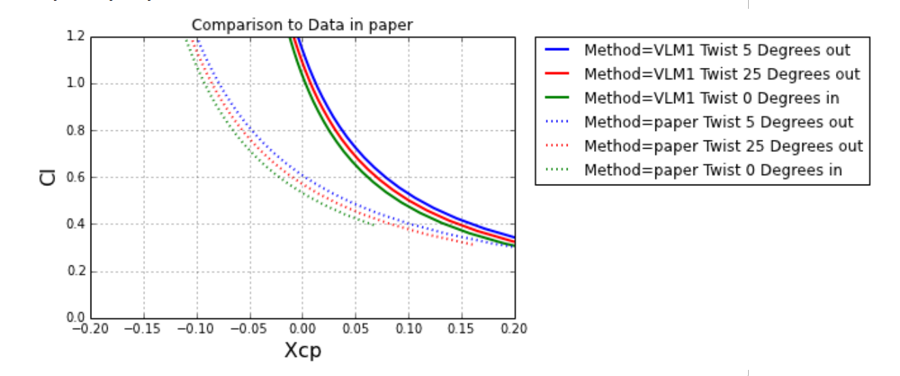
Created Wings Compared to Results in the Paper
Notes:
From Xcel spreedsheet of values that notes the foil shape
Email from colin/olivier saying
cannot find files but good to see trends match
Xcp for his wing move far in front of 0 hinting at a larger forward sweep

Slide 16
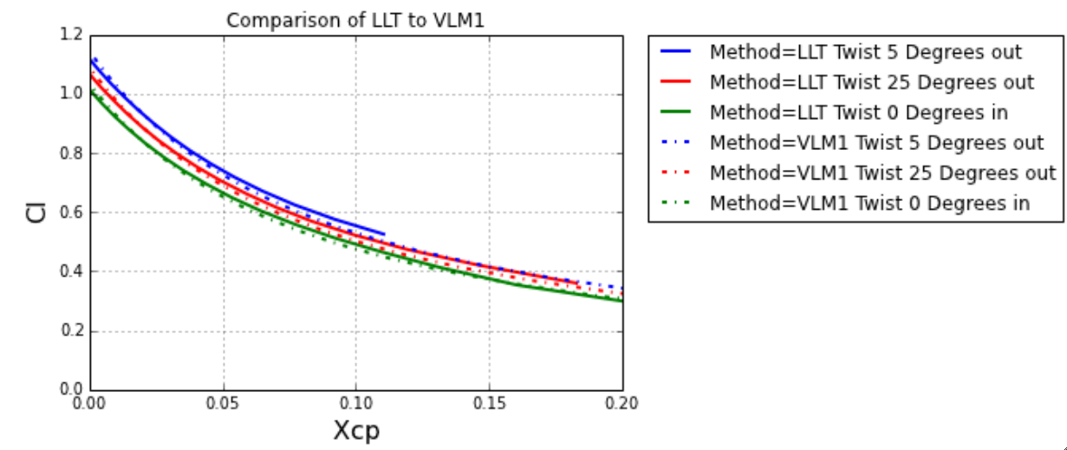
LLT Compared to VLM1 Results

Slide 17
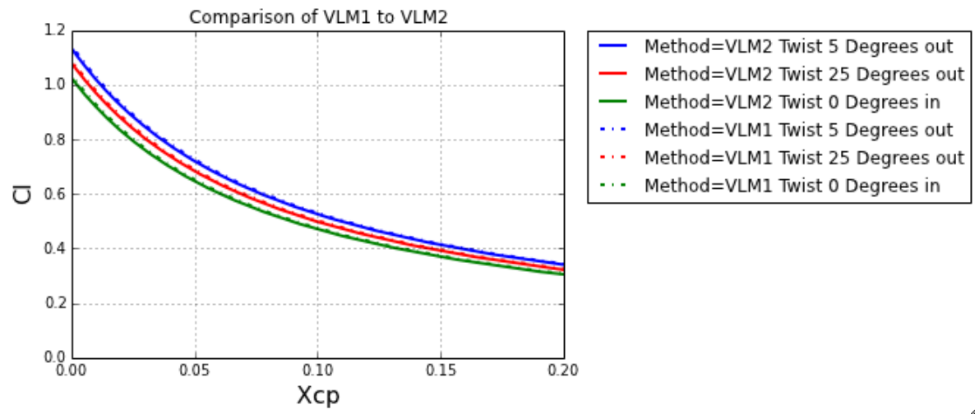
VLM2 Compared to VLM1
Notes:
Almost identical results VLM1 to VLM2

Slide 18
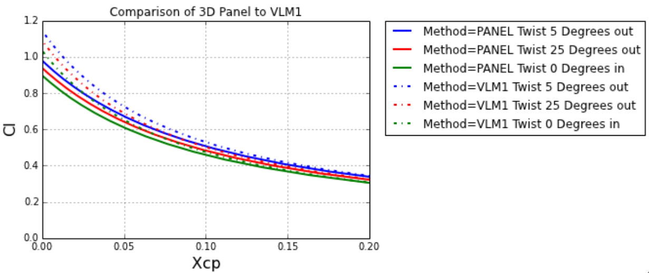
3D Panel Compared to VLM1
Notes:
High angles of attach divernt results
3D panel accounts for variable thickness
When looking at pressure distribution gives more accurate picture

Slide 19
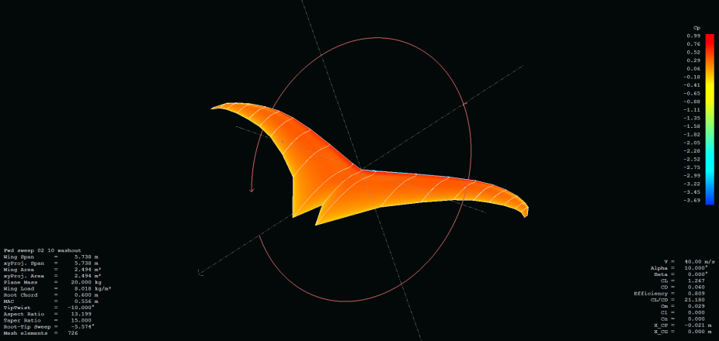
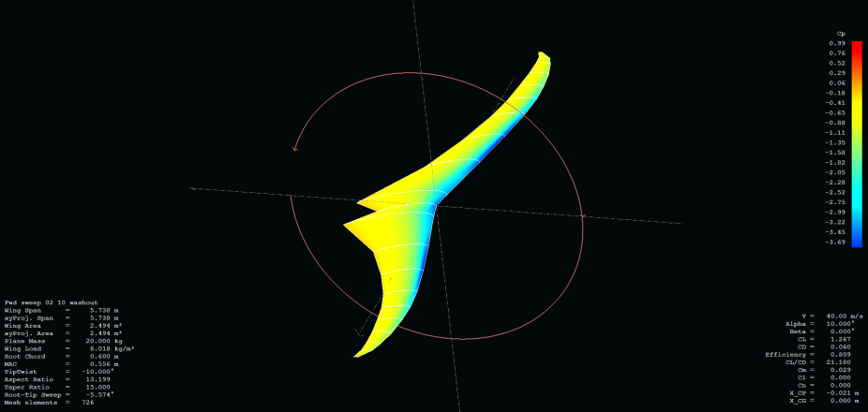
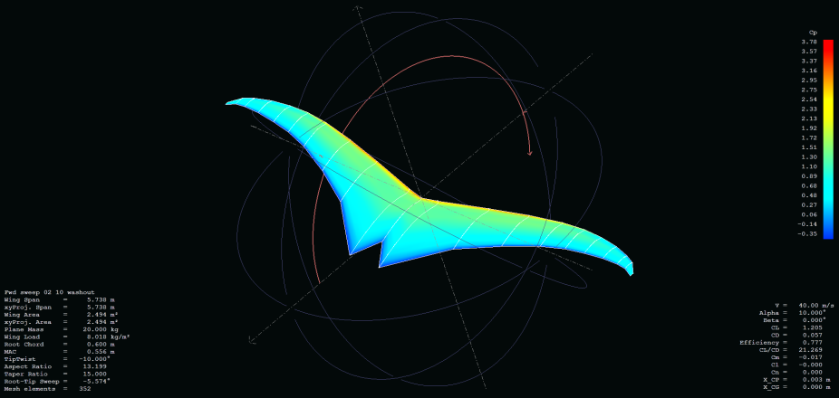
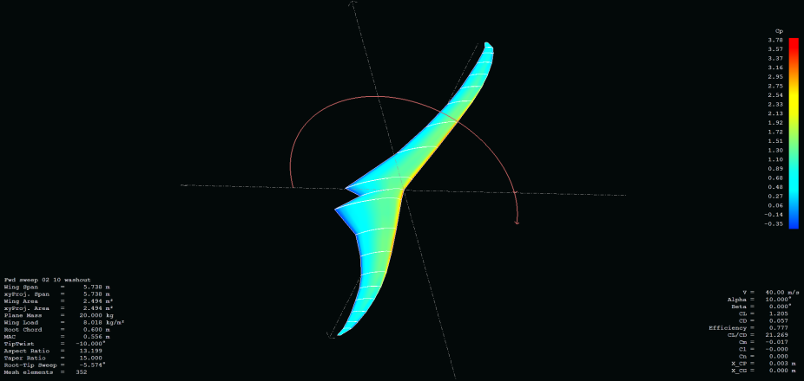
Cp Distribution
3D Panel
VLM1

Slide 20
Conclusions
VLM and 3D panel method yield different results
Due to the variable thickness, 3D Panel method may yield more accurate results
Potential flow models may be limited in flapping flight applications
Trends shown are repeatable

Slide 21
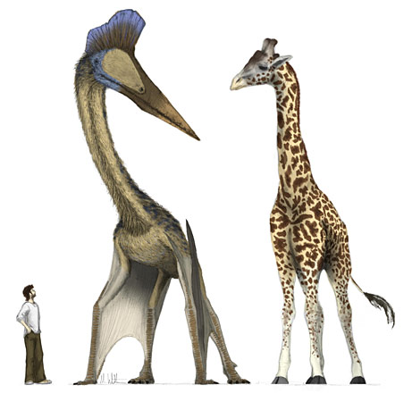
Question?

